Slide 1
Inter Symbol Interference

Slide 2
ISI
The elongation of a pulse beyond given time period causes ISI.
If Tb is the time period of a bit and Rb=1/Tb is the bit rate,
Then detector may not be able to detect the transmitted input within Tb secs.
The receiver must be able to detect the transmitted bit within Tb secs.

Slide 3
ISI
We transmit 0’s & 1,s as voltage levels as akp(t).
Since we transmit many bits or symbols then any pulse gets broadened it interferes with adjacent pulses.
This causes ISI.

Slide 4
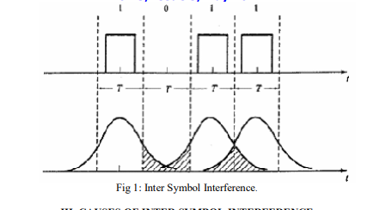
ISI

Slide 5
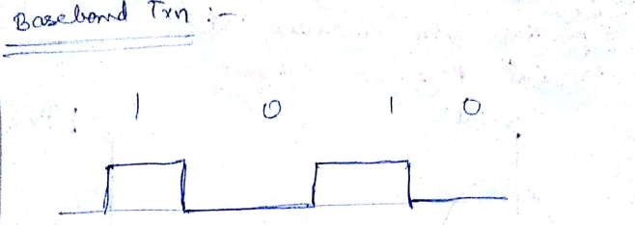
Reason for pulse spreading
i.e. cause for ISI is the channel is BLed.
In baseband transmission, each binary digit is transmitted as a rectangular pulse.

Slide 6
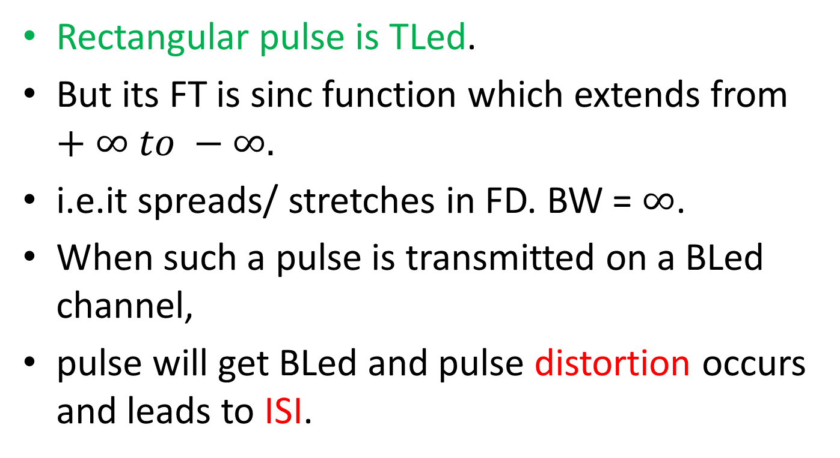
Txn of TLed Pulse
Rectangular pulse is TLed.
But its FT is sinc function which extends from $+∞ to −∞.$
i.e.it spreads/ stretches in FD. BW = $∞$.
When such a pulse is transmitted on a BLed channel,
pulse will get BLed and pulse distortion occurs and leads to ISI.

Slide 7
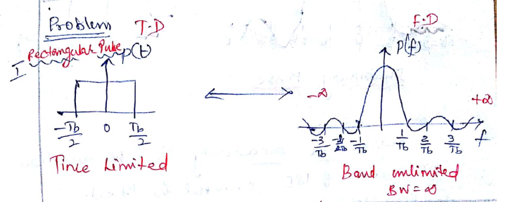
TL ed Pulse

Slide 8
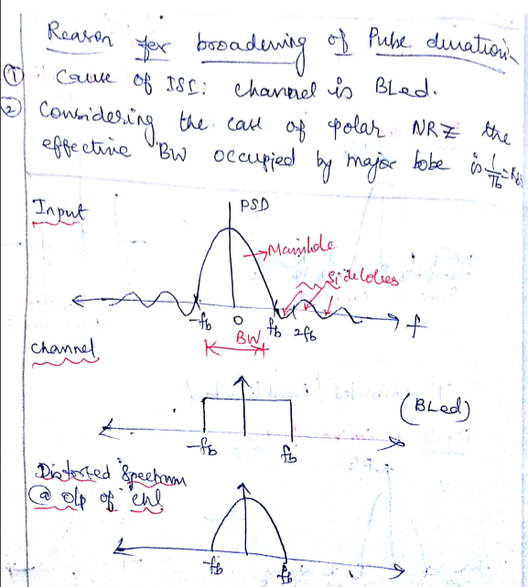
Reason for pulse spreading

Slide 9
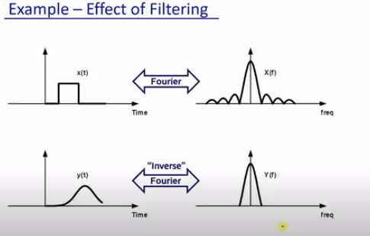
Distortion

Slide 10
Txn of TLed Pulse
So far we have chosen a rectangular pulse which has infinite BW.
Most of the energy will be concentrated in the main lobe of power spectrum.
Therefore its essential BW is finite.
When such a signal is transmitted over a BLed channel.
Most of the energy of pulse will pass through

Slide 11
Txn of TLed Pulse
But fraction of the pulse will not pass through.
i.e. small portion is suppressed.
Such a spectral distortion (in FD) tend to spread the pulse (dispersion in TD).
Causing pulse spreading and finally ISI occurs.

Slide 12
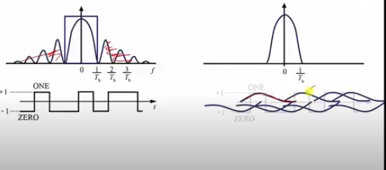
ISI

Slide 13
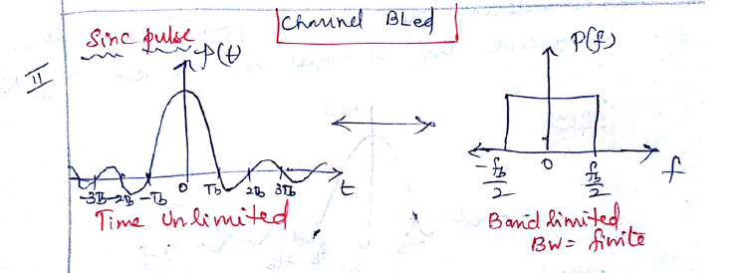
Solution: Txit BLed Pulse
A BLed pulse matches with characteristics of BLed channel.
Implies that pulse will be of infinite time
Means there will be pulse dispersion and again ISI occurs.

Slide 14
ISI
In both cases we get ISI
Cause: Pulse spreading
Need: to transmit pulses akp(t) every Tb secs
Problem: channel has finite BW
Requirement: ak’s need to be detected correctly.
Time Domain | Frequency Domain
Time Limited | Frequency Unlimited
Time Unlimited | Frequency Limited

Slide 15
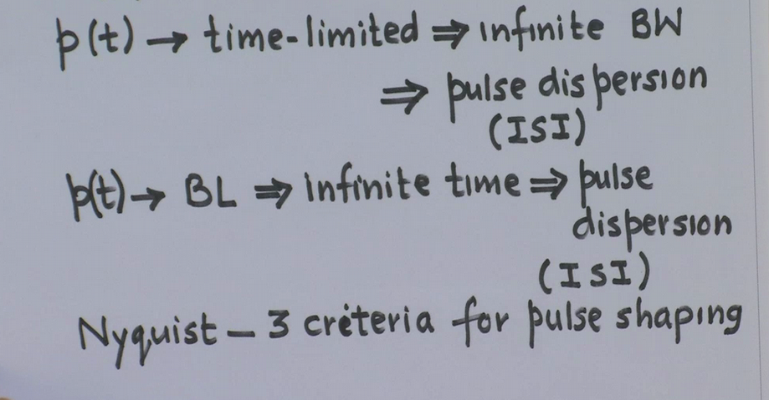
TL ed & BL ed

Slide 16
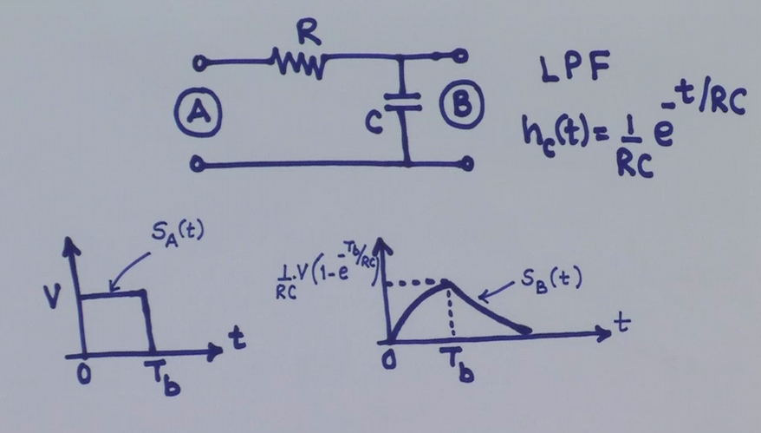
Channel Response

Slide 17
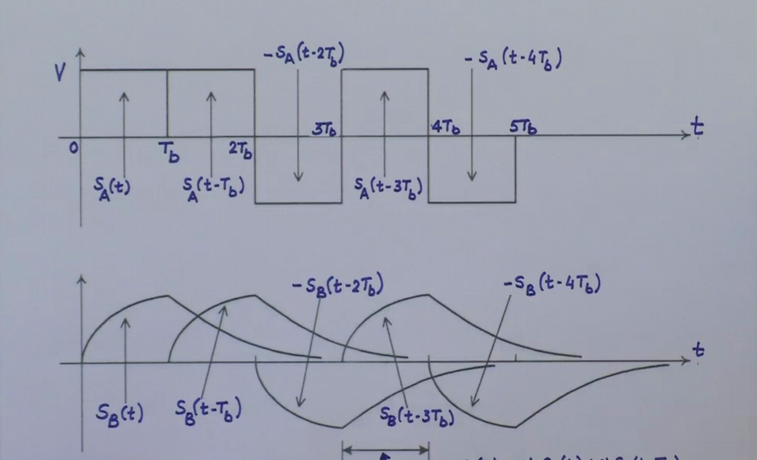
ISI

Slide 18
Solution
Here interested in pulse amplitude ak.
Pulse amplitudes can be detected correctly despite pulse spreading,
If there is no ISI at decision making instants.
This is accomplished by using a properly shaped BL ed pulses.
To eliminate ISI, Nyquist has proposed 3 criteria for Pulse shaping.

Slide 19
Solution
Whether the pulse is TLed or BLed, we get ISI.
So Nyquist suggested to use BLed pulses to eliminate ISI.
i.e. use a properly shaped BLed pulse.
Nyquist achieve ‘0’ ISI if we choose this p(t) to be such that it undergoes ‘0’ crossing every ‘Tb’ secs except for t=0.

Slide 20
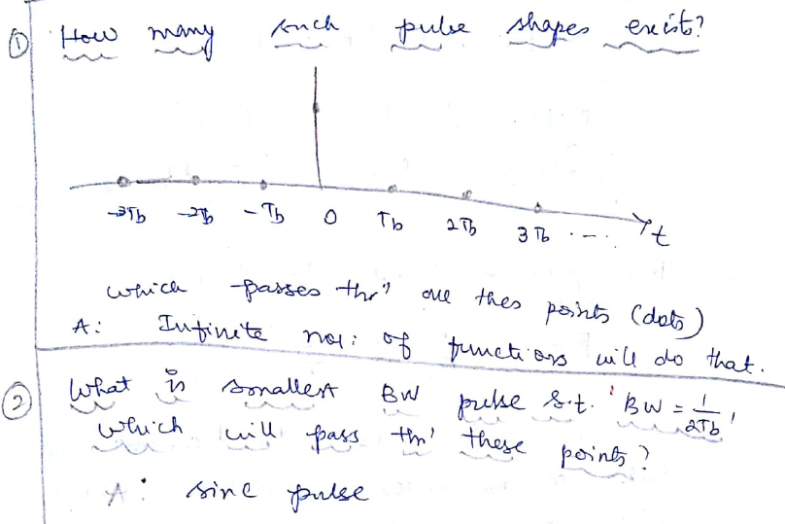
Cont..

Slide 21
Reducing ISI: Pulse Shaping
This criteria allows pulses to overlap,
In spite of overlap, they are shaped such a way that,
They cause ‘0’ or controlled interference with all other pulses at decision making instants(DMI).
Thus eliminating non-interference segments only at DMI
Eliminate need for pulse to be totally non-overlapping.

Slide 22
Pulse Shaping: Sinc Pulse
Only pulse meets this Nyquist criterion & has min BW of Rb/2 HZ is sinc pulse.
We can use this pulse to transmit at a rate of ‘Rb’ pulses per second without ISI, over a BW only Rb/2.
This shows theoretically we can use sinc pulse for transmission.

Slide 23
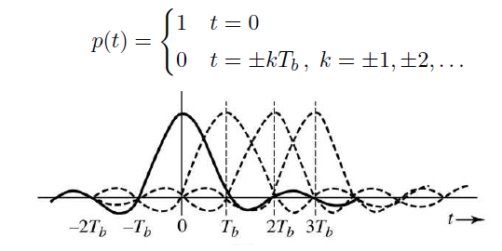
Reducing ISI: Pulse Shaping
1st criterion was that each pulse is ‘0’ at sampling instant of other pulses.

Slide 24
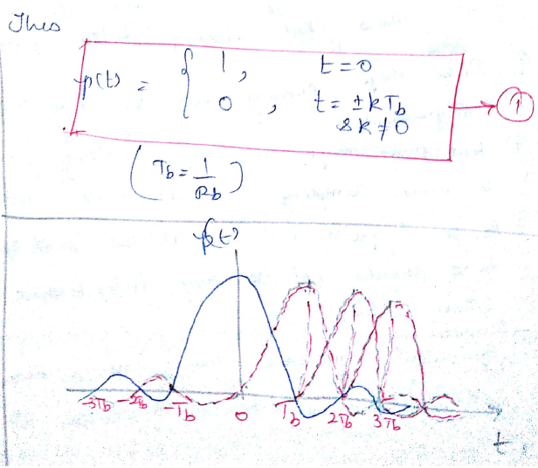
Reducing ISI: Pulse Shaping

Slide 25
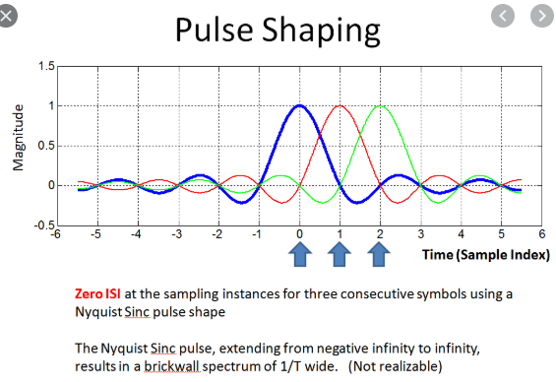
Reducing ISI: Pulse Shaping

Slide 26
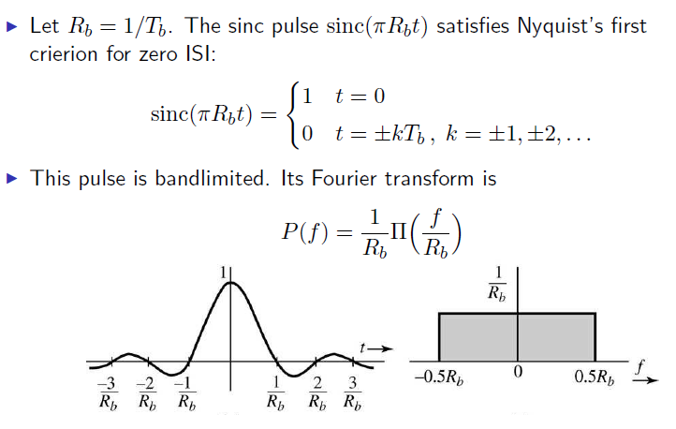
Pulse Shaping: Sinc Pulse

Slide 27
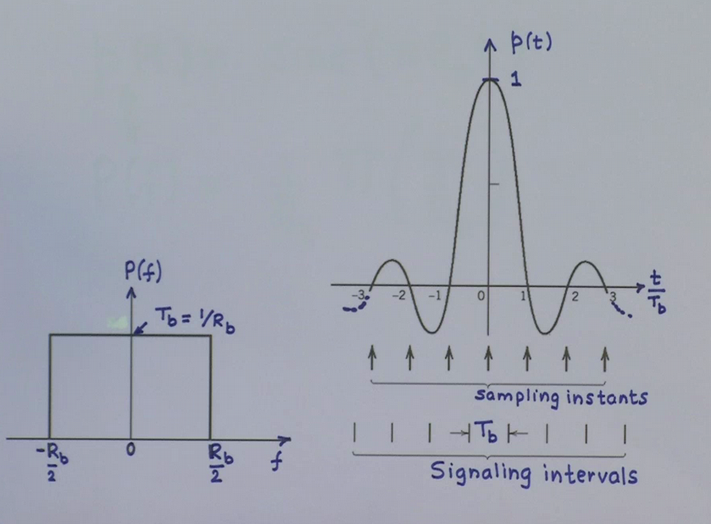
Pulse Shaping: Sinc Pulse

Slide 28
Practical Problems with sinc pulse
Sinc function is practically impossible to generate because of infinite width
Decays very slowly i.e.1/t.
Small timing error due to changes in trxn rate or sampling rate at receiver will give back ISI.

Slide 29
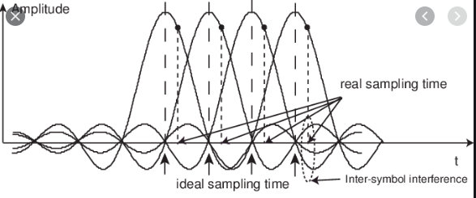
Small Timing Error

Slide 30
Reason for all these problems
FT or spectrum of sinc pulse has sharp change from non-0 value to ‘0’ value.
Any function which is very sharp in one domain will exhibit such oscillatory behavior
And such bad properties in other domain.

Slide 31
Solution
Change from non-0 value to ‘0’ value should be gradual rather than sharp.
This in turn increases the BW.
Solution is to find a pulse that satisfies equation (1) but decays faster than 1/t.
It requires a BW>fb/2. i.e. kfb.

Slide 32
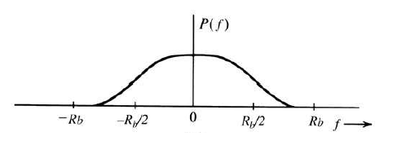
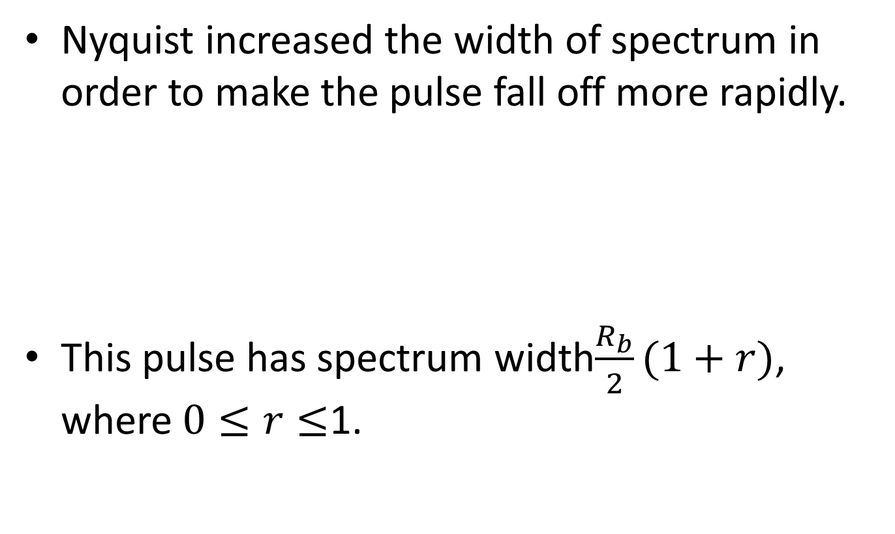
Nyquist Pulse
Nyquist increased the width of spectrum in order to make the pulse fall off more rapidly.
This pulse has spectrum width$\frac{R_{b}}{2}(1+r)$, where $0≤r≤$1.

Slide 33
Nyquist Pulse
Sample such a pulse p(t) at every ‘Tb’ secs
i.e.multiply p(t) by δ(t) (an impulse train)

Slide 34
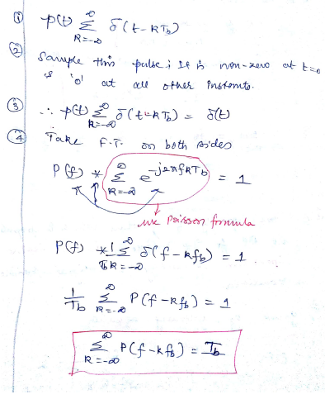
Sampling

Slide 35
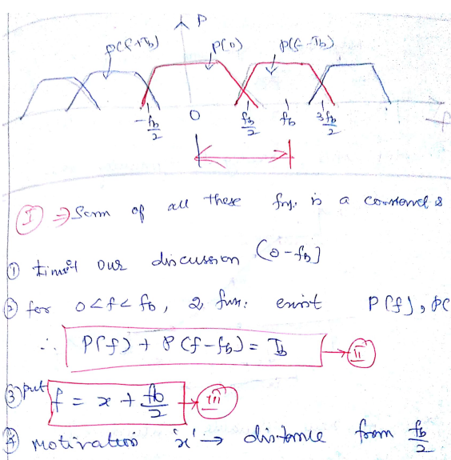
Cont…

Slide 36
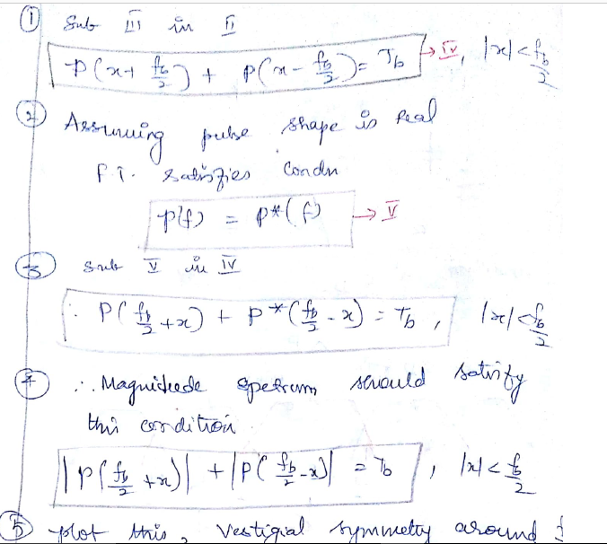
Cont..

Slide 37
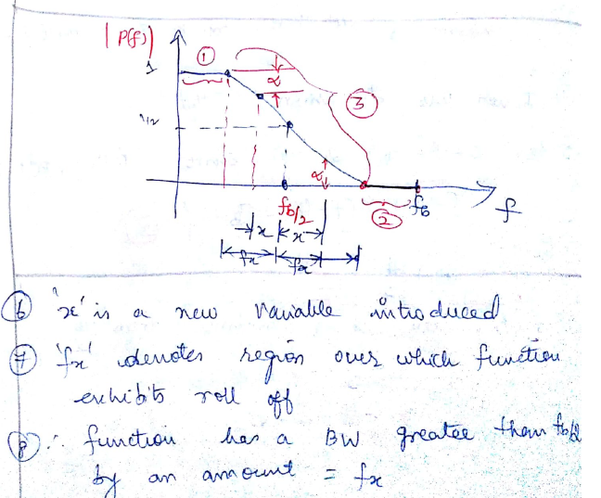
Plot

Slide 38
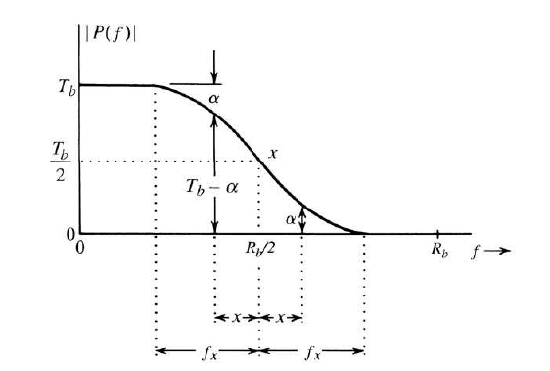
Cont…

Slide 39
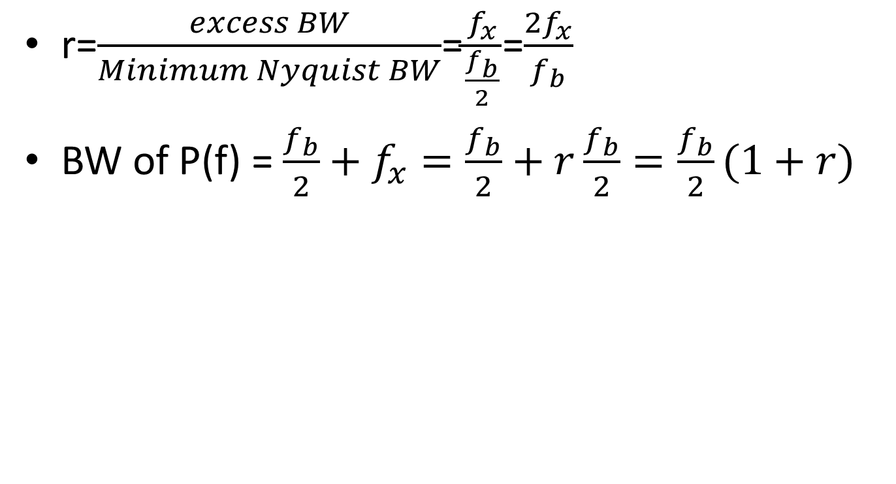
Nyquist Pulse
r=$\frac{excess BW}{Minimum Nyquist BW}$=$\frac{f_{x}}{\frac{f_{b}}{2}}$=$\frac{2f_{x}}{f_{b}}$
BW of P(f) = $\frac{f_{b}}{2}+f_{x}=\frac{f_{b}}{2}+r\frac{f_{b}}{2}=\frac{f_{b}}{2}(1+r)$

Slide 40
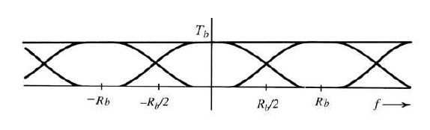
Nyquist Pulse
Since we are sampling below the Nyquist rate 2Rb, the shifted transforms overlap.
Nyquist’s criterion requires pulses whose overlaps add to Tb for all f.

Slide 41
Nyquist Pulse
Many pulse spectra satisfy this condition.
But Nyquist chose a pulse with a “vestigial” raised cosine spectrum.
It is smoother, so pulse decays more rapidly.
It is parametrized by ‘r’ called as ‘roll-off factor’.
Let ‘fx’ denote region over which function exhibits roll-off.
It denotes the excess bandwidth.

Slide 42
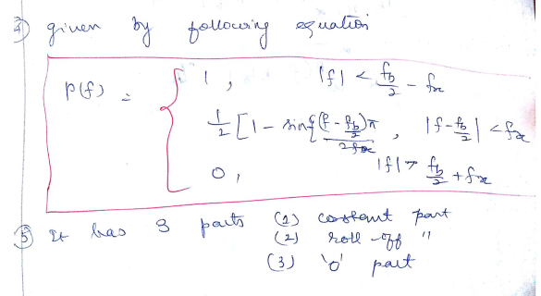
Raised Cosine Pulse

Slide 43
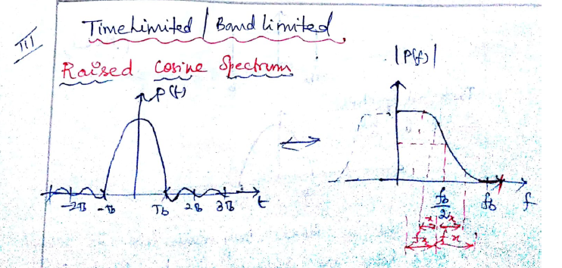
Raised Cosine Pulse

Slide 44
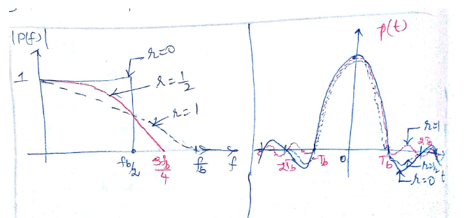
r increased from 0 to 1

Slide 45
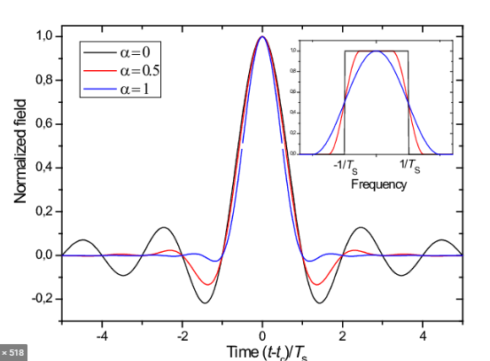
r increased from 0 to 1

Slide 46
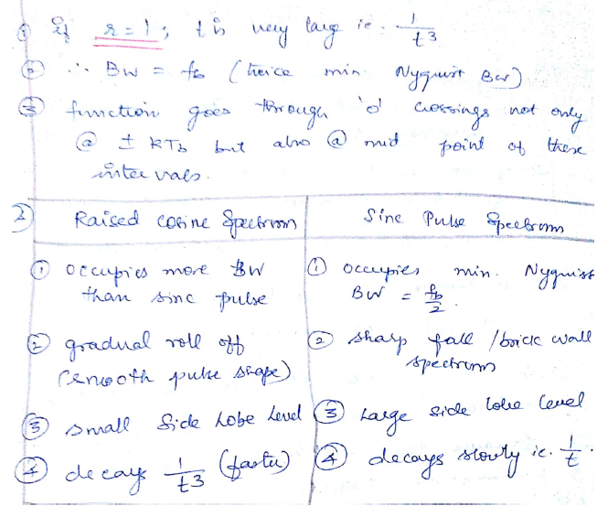
r=1

Slide 47
Raised Cosine Pulse
Raised cosine spectrum is the practical pulse shape for ‘0’ ISI
Can tolerate small timing error
Practically realizable
But only thing is it needs large BW.

Slide 48
Solution: Controlled ISI
2nd Nyquist criterion allows controlled ISI.
If we know the adjacent bits, then interference is known.
We can achieve lower BW by using an even wider pulse.
ISI can be canceled using knowledge of the pulse shape.

Slide 49
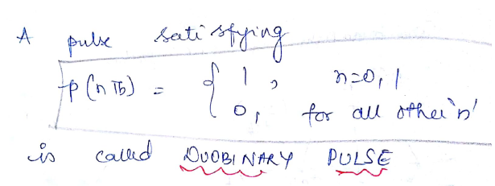
Cont..
Nyquist 2nd criteria choose a pulse

Slide 50
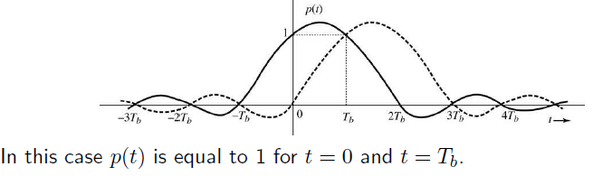
Cont…
Nyquist 2nd criterion chose a pule,
Use polar signaling for this pulse
‘1’ represented by p(t)
‘0’ represented by –p(t)

Slide 51
Cont…
Received signal is sampled at t=nTb
Such pulse cause ‘0’ ISI with all pulses except the succeeding pulse.
So need to consider ISI only with succeeding pulses.
Consider 2 successive pulses located at ‘0’ & ‘Tb’ respectively.

Slide 52
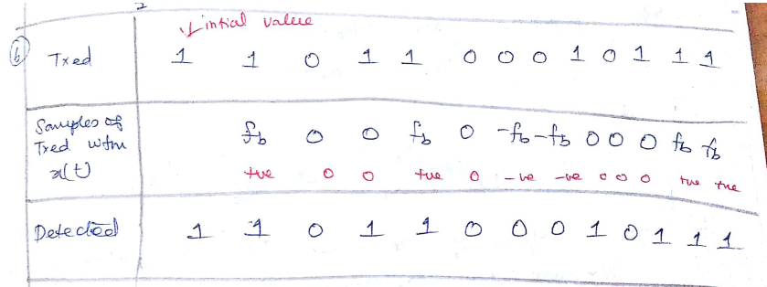
Decision Rule
At receiver, decision rule :
If sample value is +fb or +ve : present bit ‘1’
If sample value is –fb or –ve : present bit ‘0’
If sample value is ‘0’ : transtition

Slide 53
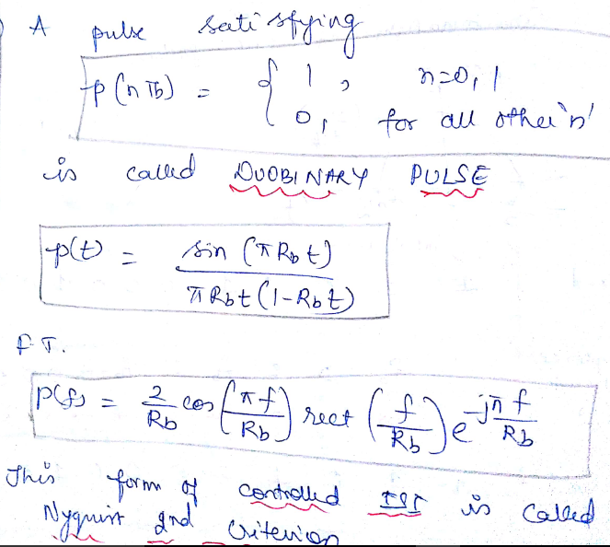

Slide 54
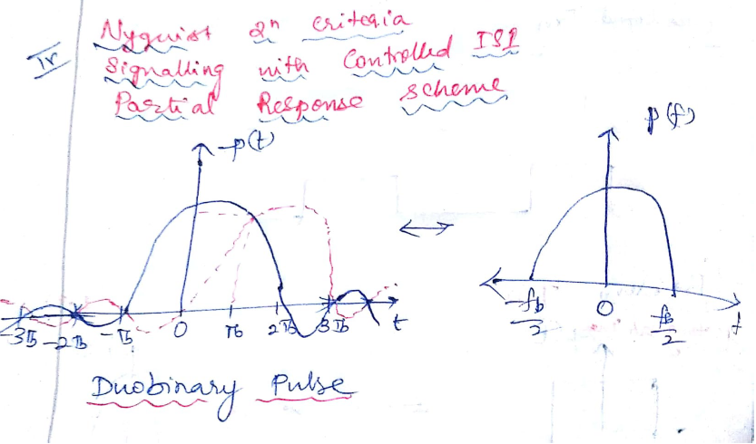

Slide 55
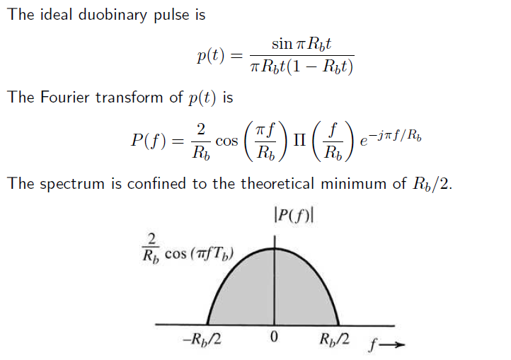
Cont…

Slide 56
Disadvantage
DC component is not ‘0’.
Error propagation occurs.
Because of transition, if any previous bit is detected wrongly it propagates.

Slide 57
Cont..
Pulse goes to 0 at t=-Tb & 2Tb
Resulting in a pulse width 50% higher than that of Nyquist 1st criterion pulse.
This results in a reduction of BW.
This scheme of controlled ISI is also known as correlative or partial response scheme.

Slide 58
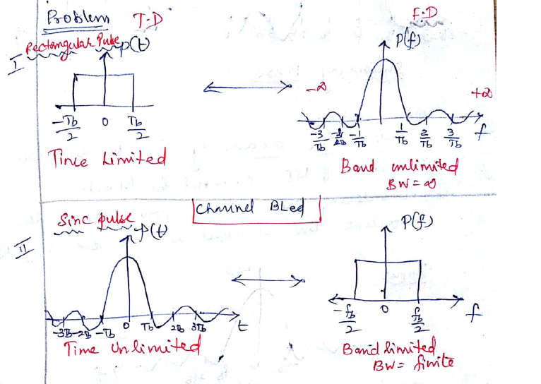
TL ed & BL ed Pulse

Slide 59
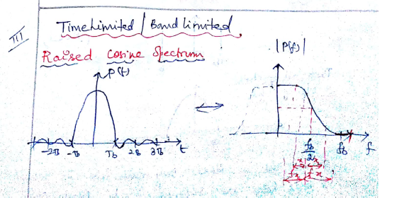
Raised Cosine Pulse

Slide 60
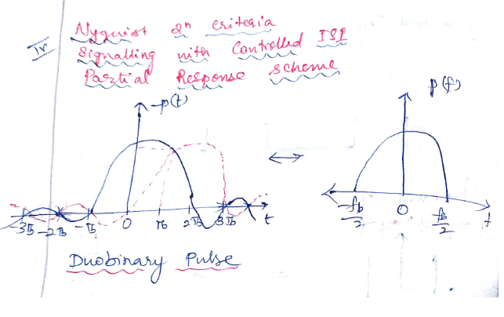
Duobinary Pulse

